Slide 1
Presentation example #1
Test presentation

Slide 2
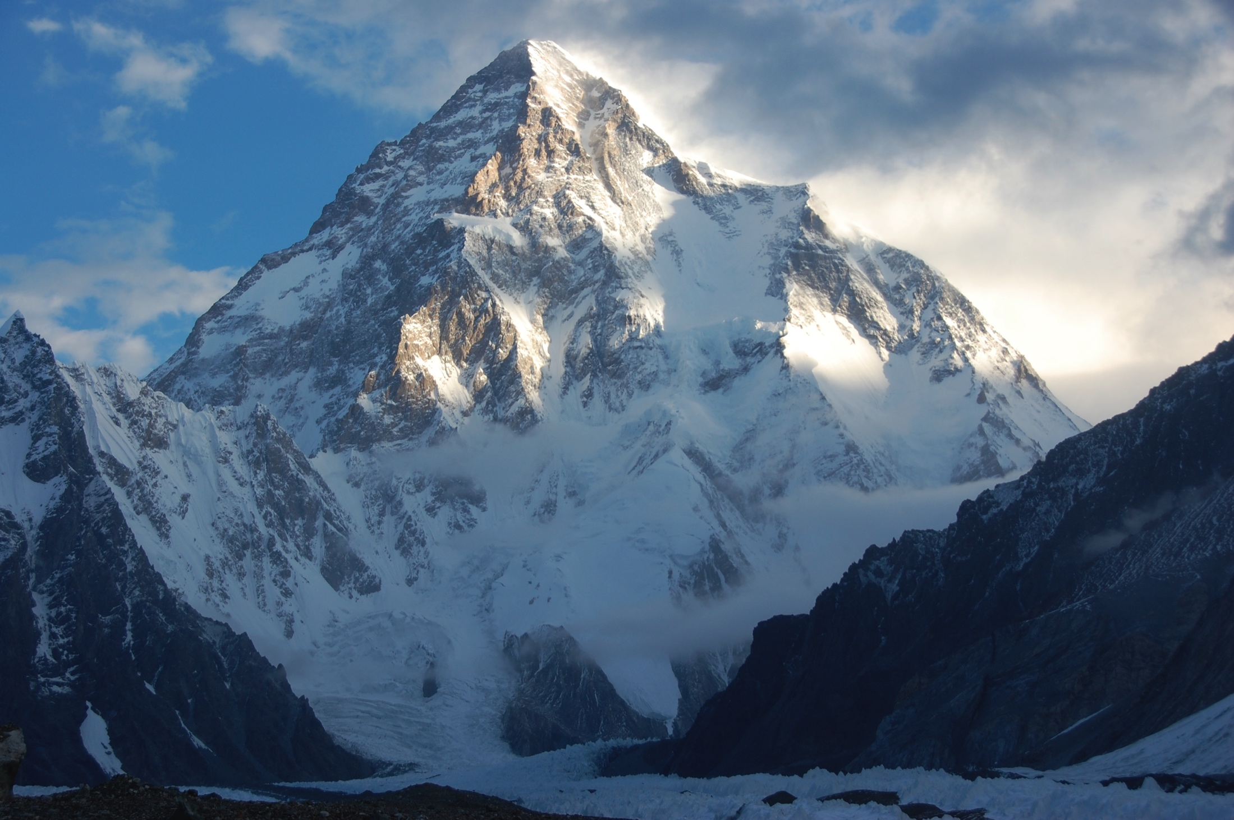
Slide 1
Mountains

Slide 3
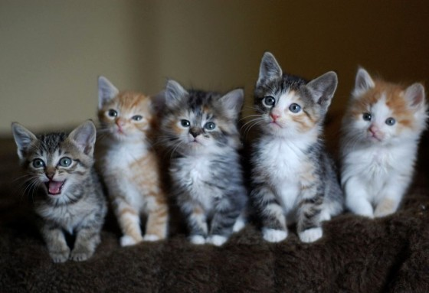
Slide 2
Kitties

Slide 4
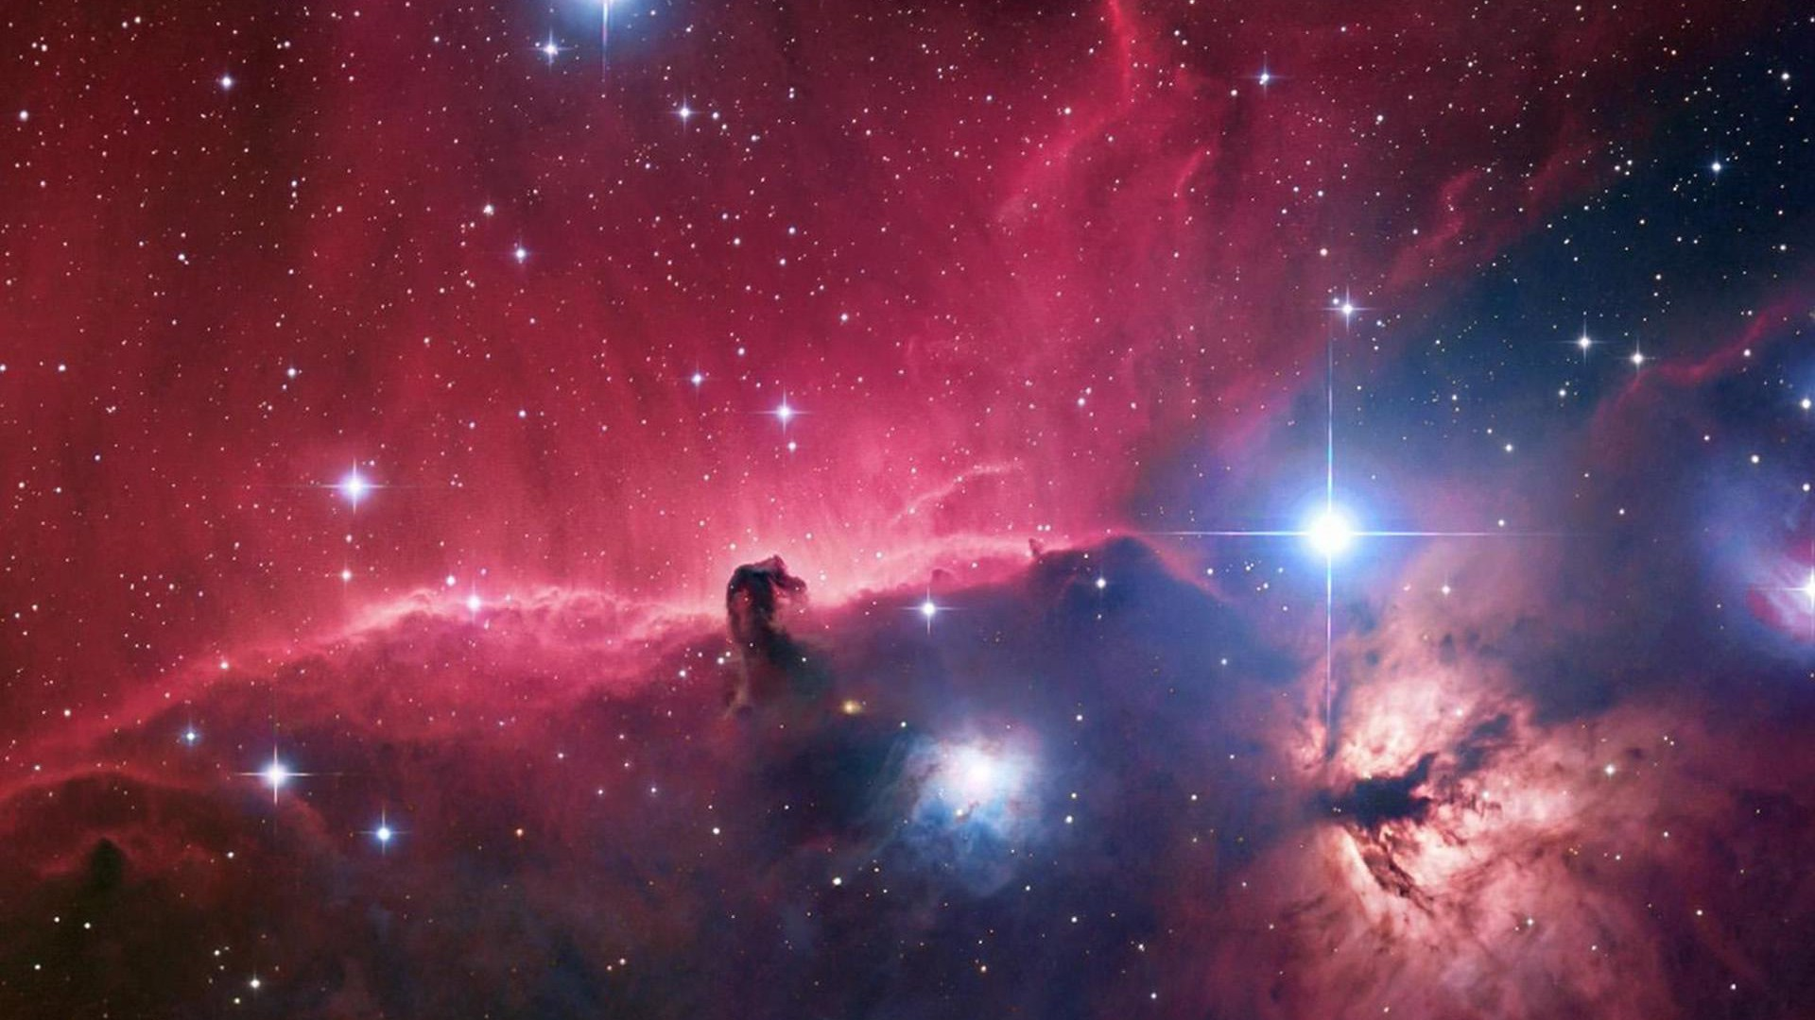
Slide 3
Space

Slide 5

Slide 4
Flower

Slide 6
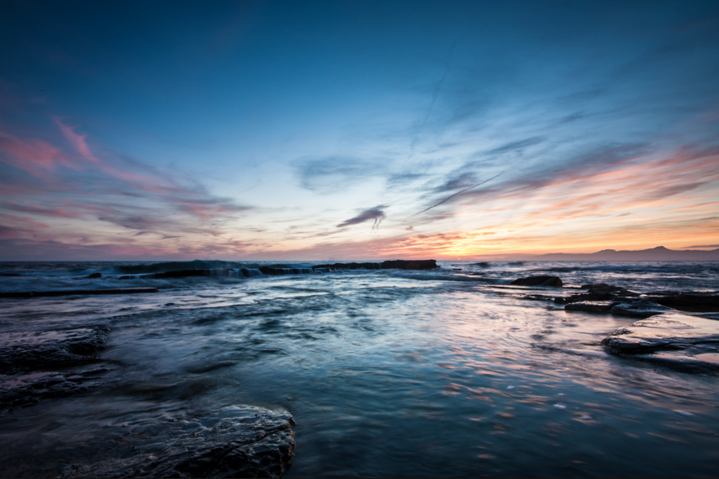
Final Slide
Sunset

Slide 7

Thank you for your attention

